Slide 1

Sentiment Analysis
Using English data set
Submitted as part of Summer Internship Project
By
Ponaganti Likitha sri
Gandipadala Sunil Kumar
Baipalli Snehalatha
Noolu Prasanna
S170414
S170904
S170458
S170191
Under the Supervision of:
Dr. Manish Shrivastava
LTRC Lab, IIIT Hyderabad

Slide 2
Topics Discussed
Sentiment Analysis Introduction
Classification and its types
Sentiment Analysis Applications
Models Used for Sentimental Analysis
NLP Topics required for Sentimental Analysis

Slide 3
Sentiment Analysis

Slide 4
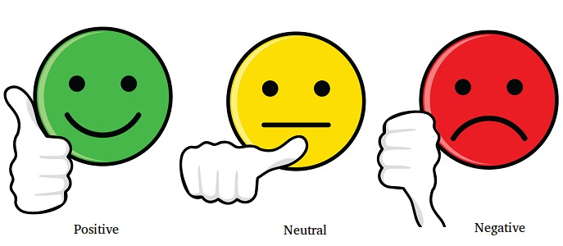
What is Sentiment Analysis?
Sentiment analysis (also known as opinion mining) is a type of natural language processing (NLP) approach that determines whether input is positive, negative, or neutral.
The method of identifying positive or negative sentiment in text is known as sentiment analysis. Businesses frequently utilise it to identify sentiment in social data, assess brand reputation, and better understand customers.
Sentiment Analysis is one of the text-classification technique.

Slide 5
Types of Sentiment Analysis
Sentiment analysis focuses on text's polarity (positive, negative, or neutral), but it also extends beyond polarity to detect particular moods and emotions (angry, glad, sad, and so on), urgency (urgent, not urgent), and even intents (interested v. not interested)
Here are a few samples of the most common forms of sentiment analysis:
Graded Sentiment Analysis( 5-star ratings system can be used)
Emotion Detection (happiness, frustration, anger, and sadness)
Aspect Based Sentiment Analysis (The battery life of this camera is too short)
Multilingual Sentiment Analysis (custom model based on our training)

Slide 6
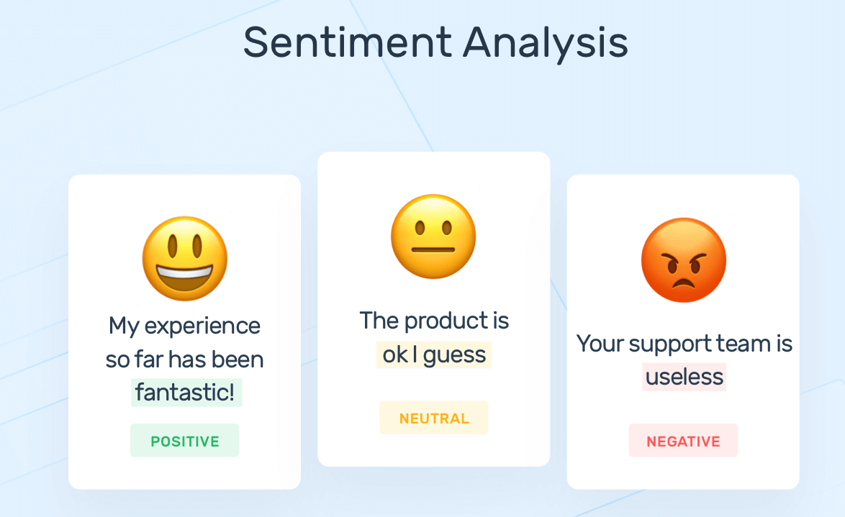
Examples

Slide 7
Classification

Slide 8
What is Classification?
A classification is a predictive modelling problem that predicts a class label for a given sample of input data.
The goal of classification is to establish which category an observation belongs to, which is accomplished by understanding the relationship between the dependent and independent variables.
There are several classification methods available for modelling classification predictive modelling challenges.

Slide 9
Types of Classification
There are four major types of classification tasks you may encounter:
Binary Classification - The classification only will have 2 labels.
Multi Class Classification - The classification will have more than 2 class labels.
Multi Label Classification - The classification will have 2 or more class labels where every time one or more labels predicted.
Imbalanced Classification - The no of examples in each class is unequally distributed. (A binary classifier).

Slide 10
Multi Class Classification

Slide 11
Multi - Class Classification
Classification tasks with more than two class labels are referred to as multi-class classification tasks. In Multi-class classification examples are categorised as belonging to one of several identified classes.
Text translation models, for example, are a sort of multi-class classification problem that involves predicting a series of words. Each word in the sequence of words to be anticipated requires a multi-class classification in which the size of the vocabulary dictates the number of potential classes that may be predicted and can range from tens to hundreds of thousands of words.

Slide 12
How can we Implement This?
Many binary classification techniques may also be utilised for multi-class classification.
Among the popular methods for multi-class categorization are:
k-Nearest Neighbors.
Decision Trees.
Naive Bayes.
Random Forest.
Gradient Boosting.

Slide 13
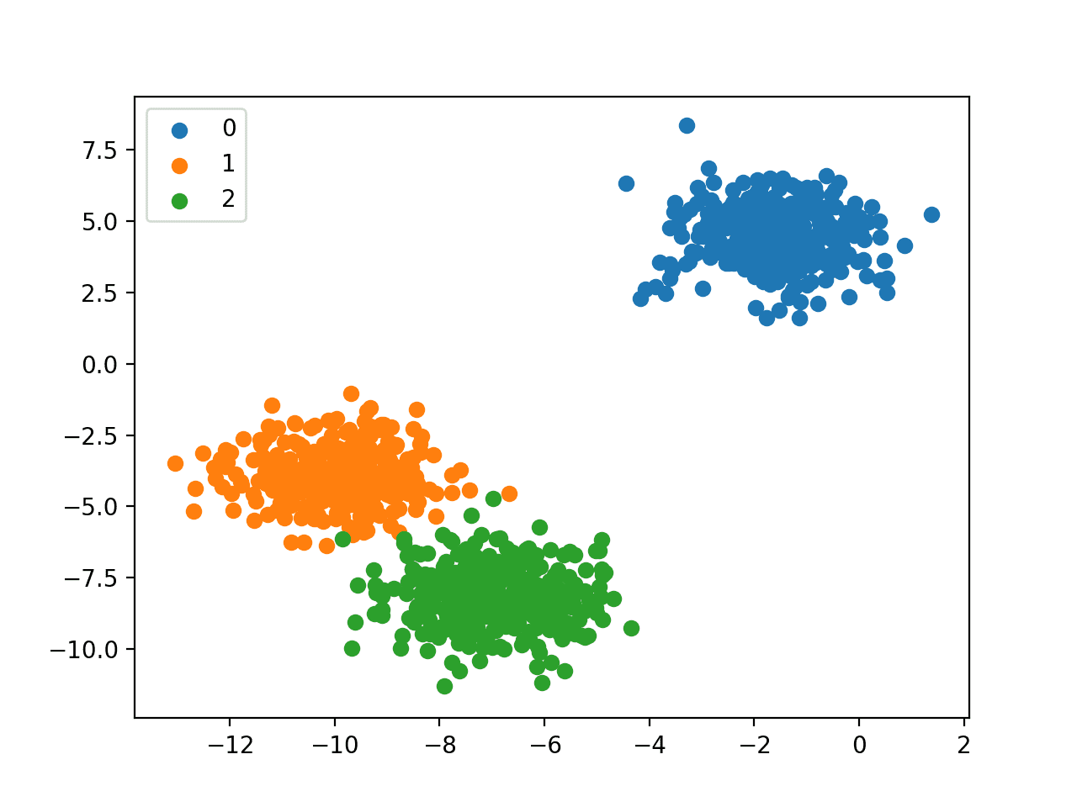
How can we Implement this?
The following binary classification algorithms can use these methodologies for multi-class classification:
Logistic Regression
implementation : https://colab.research.google.com/drive/1r3fKmsy5J2Md0efUrIXGQ4tut2grp1sa?usp=sharing
Support Vector Machine
Ex:
A business challenge in which it is necessary to categorise whether an observation is "Safe," "At-Risk," or "Unsafe" is an example of a multi-class classification problem. It should be noted that each observation may only belong to one class, and observations cannot be allocated to several classes. Thus, observation will be either "Safe," "At-Risk," or "Unsafe," and cannot be both.

Slide 14
Multi Label Classification

Slide 15
Multi Label Classification
Classification tasks with two or more class labels, where one or more class labels may be predicted for each case, are referred to as multi-label classification tasks.
Multi-label classification problems are commonly modelled with a model that predicts many outputs, with each outcome predicted as a Bernoulli probability distribution. This is a model that predicts numerous binary classifications for each case.
“Consider image classification, in which a given photo may have numerous things in the scene and a model may predict the existence of multiple known objects in the photo, such as "bicycle," "apple," "person," and so on.”

Slide 16
How can we Implement This?
Binary or multi-class classification methods cannot be utilised directly for multi-label classification. Specialized variants of traditional classification algorithms, known as multi-label algorithms, can be utilised.
Among the popular methods for multi-label categorization are:
Multi-label Decision Trees
Multi-label Random Forests
Multi-label Gradient Boosting

Slide 17
Where Sentiment analysis can be used?

Slide 18
Social Media Marketing
Social media posts often contain some of the most honest opinions about your products, services, and businesses because they’re unsolicited. With the help of sentiment analysis, you can wade through all that data in minutes, to analyze individual emotions and overall public sentiment on every social platform.
with the help of sentiment analysis software, you can wade through all that data in minutes, to analyze individual emotions and overall public sentiment on every social platform.
Sentiment analysis can read beyond simple definition to detect sarcasm, read common chat acronyms (lol, rofl, etc.), and correct for common mistakes like misused and misspelled words.

Slide 19
Customer Support
Customer Support Management represents many challenges due to the sheer number of requests, varied topics, and diverse branches within a company – not to mention the urgency of any given request.
Sentiment analysis with natural language understanding reads regular human language for meaning, emotion, tone, and more, to understand customer requests, just as a person would. You can automatically process customer support tickets, online chats, phone calls, and emails by sentiment to prioritize any urgent issues.
sentiment analysis classifier used to sort thousands of customer support messages instantly by understanding words and phrases that contain negative opinions.

Slide 20
Listen to voice of the customer (VOC)
Combine and evaluate all of your customer feedback from the web, customer surveys, chats, call centers, and emails. Sentiment analysis allows you to categorize and structure this data to identify patterns and discover recurring topics and concerns.
Listening to the voice of your customers, and learning how to communicate with your customers – what works and what doesn’t – will help you create a personalized customer experience.

Slide 21
Product Analysis
Find out what the public is saying about a new product right after launch, or analyze years of feedback you may have never seen. You can search keywords for a particular product feature (interface, UX, functionality) and use aspect based sentiment analysis to find only the information you need.
Discover how a product is perceived by your target audience, which elements of your product need to be improved, and know what will make your most valuable customers happy. All with sentiment analysis.

Slide 22
Brand Monitoring and reputation Management
Brand monitoring is one of the most popular applications of sentiment analysis in business. Bad reviews can snowball online, and the longer you leave them the worse the situation will be. With sentiment analysis tools, you will be notified about negative brand mentions immediately.
Not only that, you can keep track of your brand’s image and reputation over time or at any given moment, so you can monitor your progress. Whether monitoring news stories, blogs, forums, and social media for information about your brand, you can transform this data into usable information and statistics.

Slide 23
NLP MODELS
USED IN SENTIMENT ANALYSIS

Slide 24
NLP MODELS
Logistic Regression
Random Forest
Decision Tree
Support Vector Machine
Multi Layer Perceptron

Slide 25
Logistic Regression

Slide 26
Logistic Regression:
Logistic regression is one of the most popular Machine Learning algorithms, which comes under the Supervised Learning technique. It is used for predicting the categorical dependent variable using a given set of independent variables.
Logistic regression predicts the output of a categorical dependent variable. Therefore the outcome must be a categorical or discrete value. It can be either Yes or No, 0 or 1, true or False, etc. but instead of giving the exact value as 0 and 1, it gives the probabilistic values which lie between 0 and 1.
In logistic regression, we use the concept of the threshold value, which defines the probability of either 0 or 1. Such as values above the threshold value tends to 1, and a value below the threshold values tends to 0.

Slide 27
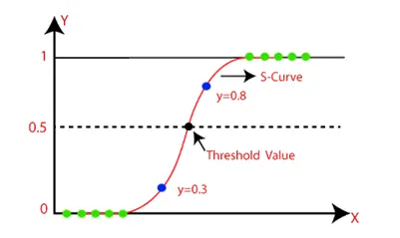
How It Works?
In Logistic regression, instead of fitting a regression line, we fit an "S" shaped logistic function, which predicts two maximum values (0 or 1). The curve from the logistic function indicates the likelihood of something such as whether the cells are cancerous or not, a mouse is obese or not based on its weight, etc.
Syntax:
from sklearn.linear_model import LogisticRegression

Slide 28
Decision Tree

Slide 29
Decision Tree
Decision Tree is a Supervised learning technique that can be used for both classification and Regression problems, but mostly it is preferred for solving Classification problems. It is a tree-structured classifier, where internal nodes represent the features of a dataset, branches represent the decision rules and each leaf node represents the outcome.
In a Decision tree, there are two nodes, which are the Decision Node and Leaf Node. Decision nodes are used to make any decision and have multiple branches, whereas Leaf nodes are the output of those decisions and do not contain any further branches.

Slide 30
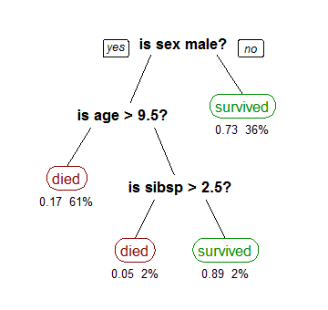
How Decision Tree Works?
In a decision tree, for predicting the class of the given dataset, the algorithm starts from the root node of the tree. This algorithm compares the values of root attribute with the record (real dataset) attribute and, based on the comparison, follows the branch and jumps to the next node.
For the next node, the algorithm again compares the attribute value with the other sub-nodes and move further. It continues the process until it reaches the leaf node of the tree.
Syntax:
from sklearn.tree import DecisionTreeClassifier

Slide 31
Decision Tree
Information Gain: It calculates how much information a feature provides us about a class.
Information Gain= Entropy(S)- [(Weighted Avg) *Entropy(each feature)
Entropy: Entropy is a metric to measure the impurity in a given attribute. It specifies randomness in data. Entropy can be calculated as:
Entropy(s)= -P(yes)log2 P(yes)- P(no) log2 P(no)

Slide 32
Random Forest

Slide 33
Random Forest
Random Forest is a popular machine learning algorithm that belongs to the supervised learning technique. It can be used for both Classification and Regression problems in ML. It is based on the concept of ensemble learning, which is a process of combining multiple classifiers to solve a complex problem and to improve the performance of the model.
Random Forest is a classifier that contains a number of decision trees on various subsets of the given dataset and takes the average to improve the predictive accuracy of that dataset.

Slide 34
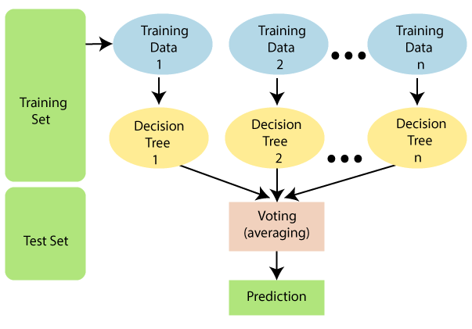
How Random Forest Works?
Random Forest works in two-phase first is to create the random forest by combining N decision tree, and second is to make predictions for each tree created in the first phase.
The Working process can be explained in the below steps and diagram:
Step-1: Select random K data points from the training set.
Step-2: Build the decision trees associated with the selected data points (Subsets).
Step-3: Choose the number N for decision trees that you want to build.
Step-4: Repeat Step 1 & 2.
Step-5: For new data points, find the predictions of each decision tree, and assign the new data points to the category that wins the majority votes.
Syntax:
from sklearn.ensemble import RandomForestClassifier

Slide 35
Support Vector Machine

Slide 36
Support Vector machine
Support vector machines so called as SVM is a supervised learning algorithm which can be used for classification and regression problems as support vector classification (SVC) and support vector regression (SVR). It is used for smaller dataset as it takes too long to process.
SVM is based on the idea of finding a hyperplane that best separates the features into different domains.

Slide 37
Terminologies:
Support Vectors: These are the points that are closest to the hyperplane. A separating line will be defined with the help of these data points.
Margin: it is the distance between the hyperplane and the observations closest to the hyperplane (support vectors). In SVM large margin is considered a good margin. There are two types of margins hard margin and soft margin. I will talk more about these two in the later section.
Syntax:
from sklearn import svm
clf=svm.SVM()

Slide 38
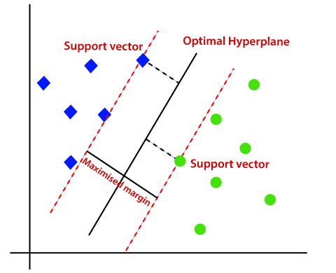
How it works
Suppose we have a dataset that has two classes (green and blue). We want to classify that the new data point as either blue or green.
To classify these points, we can have many decision boundaries, but the question is which is the best and how do we find it?
The best hyperplane is that plane that has the maximum distance from both the classes, and this is the main aim of SVM. This is done by finding different hyperplanes which classify the labels in the best way then it will choose the one which is farthest from the data points or the one which has a maximum margin.

Slide 39
Multilayer Perceptron

Slide 40
Multilayer Perceptron
A Multilayer Perceptron has input and output layers, and one or more hidden layers with many neurons stacked together. And while in the Perceptron the neuron must have an activation function that imposes a threshold, like ReLU or sigmoid, neurons in a Multilayer Perceptron can use any arbitrary activation function.
A multi-layer perceptron has one input layer and for each input, there is one neuron(or node), it has one output layer with a single node for each output and it can have any number of hidden layers and each hidden layer can have any number of nodes.
Syntax:
from sklearn.neural_network import MLPClassifier clf = MLPClassifier()

Slide 41
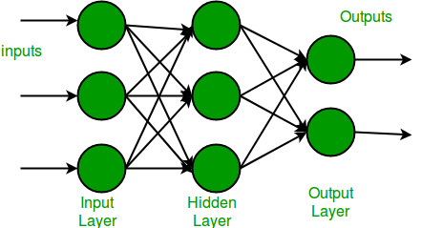
The nodes in the input layer take input and forward it for further process, in the diagram above the nodes in the input layer forwards their output to each of the three nodes in the hidden layer, and in the same way, the hidden layer processes the information and passes it to the output layer.
Every node in the multilayer perceptron uses a sigmoid activation function. The sigmoid activation function takes real values as input and converts them to numbers between 0 and 1 using the sigmoid formula.
(x)=1/(1+exp(-x))
Each layer is represented as y = f(W*X+ b). Where f is the activation function (covered below), W is the set of parameter, or weights, in the layer, X is the input vector, which can also be the output of the previous layer, and b is the bias vector.

Slide 42
NLP TOPICS
Used in Sentiment Analysis

Slide 43
NLP TOPICS
Scikit Learn(sklearn)
TF-IDF Vectorizer
Countvectorizer
One -hot encoding
Label Encoder
Pipeline
Scikit Learn Metrics
Used in Sentiment Analysis

Slide 44
Scikit Learn

Slide 45
Scikit-Learn
Scikit-learn (Sklearn) is the most useful and robust library for machine learning in Python. It provides a selection of efficient tools for machine learning and statistical modeling including classification, regression, clustering and dimensionality reduction via a consistent interface in Python. This library, which is largely written in Python, is built upon NumPy, SciPy and Matplotlib.

Slide 46
Features:
Rather than focusing on loading, manipulating and summarising data, Scikit-learn library is focused on modeling the data. Some of the most popular groups of models provided by Sklearn are as follows −
Supervised Learning algorithms − Almost all the popular supervised learning algorithms, like Linear Regression, Support Vector Machine (SVM), Decision Tree etc., are the part of scikit-learn.
Unsupervised Learning algorithms − On the other hand, it also has all the popular unsupervised learning algorithms from clustering, factor analysis, PCA (Principal Component Analysis) to unsupervised neural networks.
Clustering − This model is used for grouping unlabeled data.
Cross Validation − It is used to check the accuracy of supervised models on unseen data.
Dimensionality Reduction − It is used for reducing the number of attributes in data which can be further used for summarisation, visualisation and feature selection.
Ensemble methods − As name suggest, it is used for combining the predictions of multiple supervised models.
Feature extraction & Selection − It is used to extract the features from data to define the attributes in image and text data and to identify useful attributes to create supervised models.

Slide 47

TF-IDF:
TFIDF works by proportionally increasing the number of times a word appears in the document but is counterbalanced by the number of documents in which it is present. Hence, words like ‘this’, ’are’ etc., that are commonly present in all the documents are not given a very high rank. However, a word that is present too many times in a few of the documents will be given a higher rank as it might be indicative of the context of the document.
Term Frequency:Term frequency is defined as the number of times a word (i) appears in a document (j) divided by the total number of words in the document.

Slide 48

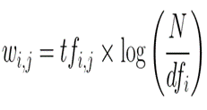
TF-IDF Vectorizer
Inverse Document Frequency:Inverse document frequency refers to the log of the total number of documents divided by the number of documents that contain the word. The logarithm is added to dampen the importance of a very high value of IDF.
TFIDF is computed by multiplying the term frequency with the inverse document frequency.
Syntax:
class sklearn.feature_extraction.text.TfidfVectorizer(
*, input='content', encoding='utf-8', decode_error='strict', strip_accents=None, lowercase=True, preprocessor=None, tokenizer=None, analyzer='word', stop_words=None, token_pattern='(?u)\b\w\w+\b', ngram_range=(1, 1)
)

Slide 49
CountVectorizer
CountVectorizer is generally used for featurization of text data
CountVectorizer converts the text data into a machine-readable form.
Count Vectorization involves counting the number of occurrences each words appears in a document (i.e distinct text such as an article, book, even a paragraph!).
Python Scikit learn library has a tool called CountVectorizer to accomplish this.
Example sentence: “The weather was wonderful today and I went outside to enjoy the beautiful and sunny weather.
CountVectorizer:

Slide 50
One-Hot Encoding:
Most Machine Learning algorithms cannot work with categorical data and needs to be converted into numerical data. Sometimes in datasets, we encounter columns that contain categorical features (string values) for example parameter Gender will have categorical parameters like Male, Female. These labels have no specific order of preference and also since the data is string labels, machine learning models misinterpreted that there is some sort of hierarchy in them.
One approach to solve this problem can be label encoding where we will assign a numerical value to these labels for example Male and Female mapped to 0 and 1. But this can add bias in our model as it will start giving higher preference to the Female parameter as 1>0 and ideally both labels are equally important in the dataset. To deal with this issue we will use One Hot Encoding technique.
Syntax:
from sklearn.preprocessing import OneHotEncoder

Slide 51
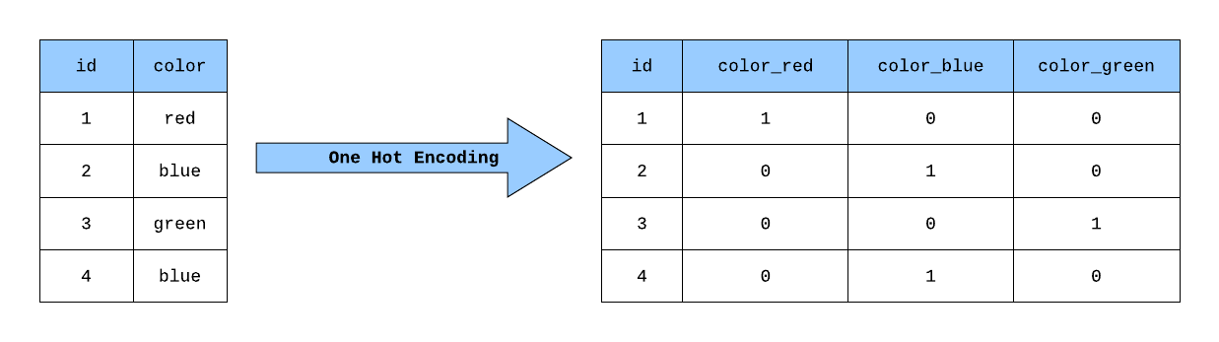
In this technique, the categorical parameters will prepare separate columns for both Male and Female labels. So, wherever there is Male, the value will be 1 in Male column and 0 in Female column, and vice-versa. Let’s understand with an example: Consider the data where fruits and their corresponding categorical values and prices are given.
Example:

Slide 52
Label Encoder
LabelEncoder is a utility class to help normalize labels such that they contain only values between 0 and n_classes-1. This is sometimes useful for writing efficient Cython routines.
This transformer(label encoder) should be used to encode target values, i.e. y, and not the input X
One hot encoder is an example of label encoder.
Syntax:
class sklearn.preprocessing.LabelEncoder #to import the class
LabelEncoder can be used to normalize labels.
It can also be used to transform non-numerical labels (as long as they are hashable and comparable) to numerical labels.
By using fit_transform() & inverse_transform() method we can do the encoding and decoding respectively.

Slide 53
Label Encoder
Methods
Example:
>>> le = preprocessing.LabelEncoder()
>>> le.fit(["paris", "paris", "tokyo", "amsterdam"])
LabelEncoder()
>>> list(le.classes_)
['amsterdam', 'paris', 'tokyo']
>>> le.transform(["tokyo", "tokyo", "paris"])
array([2, 2, 1]...)
>>> list(le.inverse_transform([2, 2, 1]))
['tokyo', 'tokyo', 'paris']
fit(y) | Fit label encoder.
fit_transform(y) | Fit label encoder and return encoded labels.
get_params([deep]) | Get parameters for this estimator.
inverse_transform(y) | Transform labels back to original encoding.
set_params(**params) | Set the parameters of this estimator.
transform(y) | Transform labels to normalized encoding.

Slide 54
Pipeline
Transformers are usually combined with classifiers, regressors or other estimators to build a composite estimator. The most common tool is a Pipeline. Pipeline is often used in combination with FeatureUnion which concatenates the output of transformers into a composite feature space.
Pipeline can be used to chain multiple estimators into one. This is useful as there is often a fixed sequence of steps in processing the data, for example feature selection, normalization and classification. Pipeline serves multiple purposes here:
Convenience and encapsulation
Joint parameter selection
Safety
Syntax: from sklearn.pipeline import Pipeline
The Pipeline is built using a list of (key, value) pairs, where the key is a string containing the name you want to give this step and value is an estimator object:
estimators = [('reduce_dim', PCA()), ('clf', SVC())]
>>> pipe = Pipeline(estimators)

Slide 55
Pipeline
Sequentially apply a list of transforms and a final estimator. Intermediate steps of the pipeline must be ‘transforms’, that is, they must implement fit and transform methods. The final estimator only needs to implement fit. The transformers in the pipeline can be cached using memory argument.
The purpose of the pipeline is to assemble several steps that can be cross-validated together while setting different parameters. For this, it enables setting parameters of the various steps using their names and the parameter name separated by a '__', as in the example below. A step’s estimator may be replaced entirely by setting the parameter with its name to another estimator, or a transformer removed by setting it to 'passthrough' or None.

Slide 56
Sklearn Metrics
The sklearn.metrics module implements functions assessing prediction error for specific purposes.
The sklearn. metrics module implements several loss, score, and utility functions to measure classification performance. Some metrics might require probability estimates of the positive class, confidence values, or binary decisions values.
The sklearn.metrics module includes score functions, performance metrics and pairwise metrics and distance computations.

Slide 57
accuracy_score
Accuracy classification score.
In multilabel classification, this function computes subset accuracy: the set of labels predicted for a sample must exactly match the corresponding set of labels in y_true.
Syntax:
sklearn.metrics.accuracy_score(y_true,
y_pred,*,normalize=True,sample_weight=None)
Returns accuracy in float value

Slide 58
classification_report
Precision:
The precision is the ratio tp / (tp + fp) where tp is the number of true positives and fp the number of false positives. The precision is intuitively the ability of the classifier not to label a negative sample as positive.
Recall:
The recall is the ratio tp / (tp + fn) where tp is the number of true positives and fn the number of false negatives. The recall is intuitively the ability of the classifier to find all the positive samples.
F1 Score
The F-beta score can be interpreted as a weighted harmonic mean of the precision and recall, where an F-beta score reaches its best value at 1 and worst score at 0.
Support:
The support is the number of occurrences of each class in y_true.
Precision
Recall
F1 score
Support

Slide 59
Models Report
MODEL | Weighted Averages |  |  | Accuracy_score | Predicted Result on ["Hulu has a great UI "]
 | Precision | recall | f1-score
Logistic Regression Model | 0.64 | 0.68 | 0.64 | 0.68 | POSITIVE
Random Forest | 0.62 | 0.64 | 0.62 | 0.64 | NEUTRAL
Decision Tree | 0.56 | 0.56 | 0.56 | 0.56 | NEUTRAL
SVM | 0.65 | 0.68 | 0.65 | 0.68 | POSITIVE
Multi Level Perceptron | 0.66 | 0.66 | 0.66 | 0.65 | POSITIVE

Slide 60
References
Sentiment Analysis - https://monkeylearn.com/sentiment-analysis/ Classification - https://machinelearningmastery.com/types-of-classification-in-machine-learning/
Regression -- https://www.javatpoint.com/logistic-regression-in-machine-learning
Decision Tree - https://www.javatpoint.com/machine-learning-decision-tree-classification-algorithm
Random Forest - https://www.javatpoint.com/machine-learning-random-forest-algorithm
Sklearn - https://www.tutorialspoint.com/scikit_learn/index.htm
TFIDF - https://www.analyticsvidhya.com/blog/2021/07/bag-of-words-vs-tfidf-vectorization-a-hands-on-tutorial/
CountVectorizer - https://pianalytix.com/countvectorizer-in-nlp/#:~:text=CountVectorizer%20means%20breaking%20down%20a,data%20needs%20to%20be%20vectorized.
one- hot Encoding - https://www.geeksforgeeks.org/ml-one-hot-encoding-of-datasets-in-python/

Slide 61
References
Label Encoder - https://scikit-learn.org/stable/modules/generated/sklearn.preprocessing.LabelEncoder.html#sklearn.preprocessing.LabelEncoder
Pipeline - https://scikit-learn.org/stable/modules/generated/sklearn.pipeline.Pipeline.html#sklearn.pipeline.Pipeline
Sklearn metrics
Accuracy score - https://scikit-learn.org/stable/modules/generated/sklearn.metrics.accuracy_score.html
Classification-report - https://scikit-learn.org/stable/modules/generated/sklearn.metrics.classification_report.htm

Slide 62
Thank You
s170414@rguktsklm.ac.in s170904@rguktsklm.ac.in snehabaipalli@gmail.com s170191@rguktsklm.ac.in

